Slide 1
Westy’s UML Diagram
Screenshots & Annotations

Slide 2
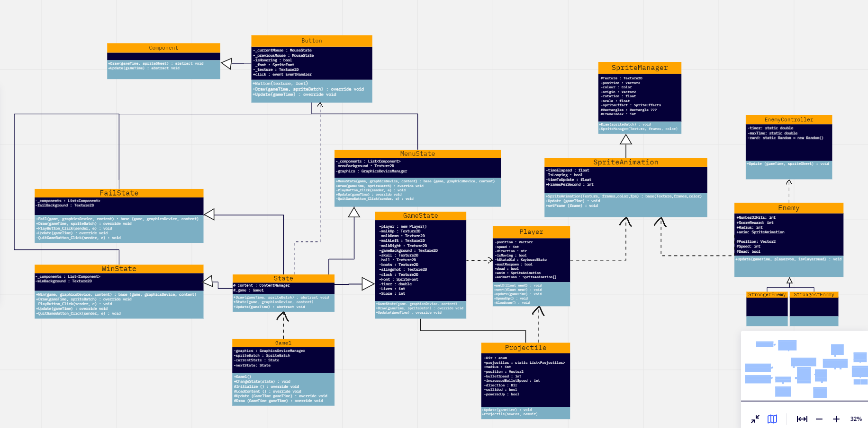
Full View

Slide 3
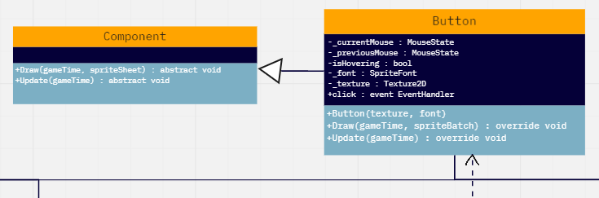
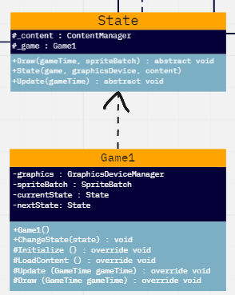
The Game1 – State – Component – Button connection
In previous games, I’ve used Game1 to load everything all at once – in this game, I plan to create a ‘State’ parent class that is dependent on Game1 to switch between scenes.
These scenes will use clickable buttons to get a player’s mouse input before moving them to the next scene, all while Game1 is initializing screen size, loading the current state’s content, and then drawing it to the screen.
The buttons are a familiar concept, but because there will be states for winning, losing and a main menu I decided it would be best to make a parent class for components like it. They’ll be called by the state classes and button class.

Slide 4
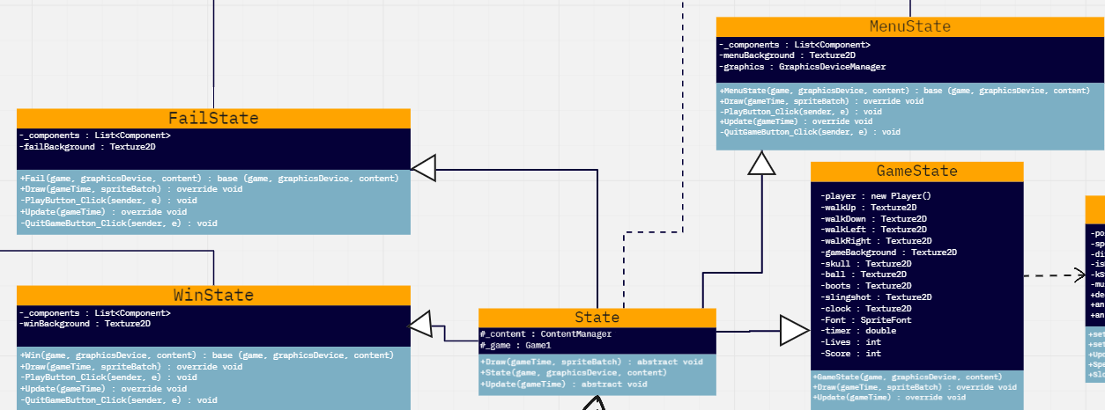
The State, MenuState, WinState and FailState connection
As mentioned in the previous slide, these states all inherit from a ‘state’ parent class that will ensure that their textures are drawn and content is loaded; private methods within the classes will also give their buttons code to execute, and the association with the Button class means that the mouse events are called for all buttons in the states.

